Slide 1


A PROJECT BASED ON PHP
Y.SRI GANESH REDDY (URK20CS1043)
UNDER SUPERVISION OF
MR T.V. K. RAO (DGM)

Slide 2
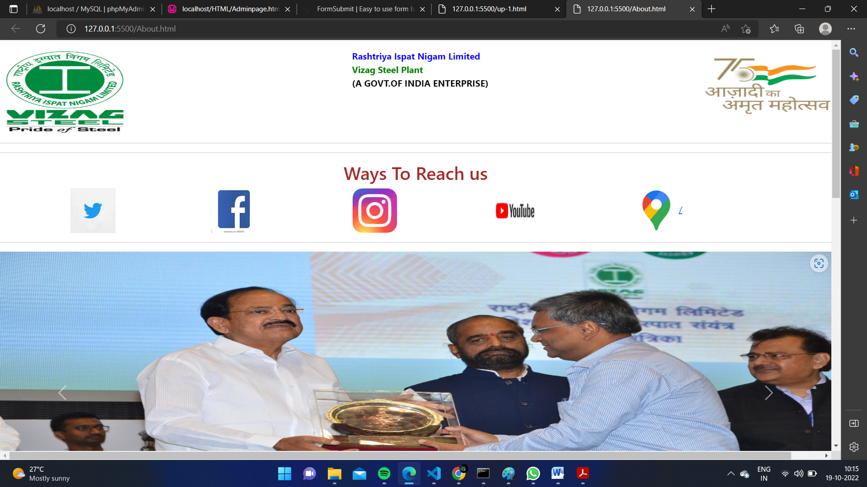
Agenda
Introduction
Objective
Technical Exposure Gained
System Architecture
Implementation Details
Impacts of Internship
Environment Learning
Conclusions and Future Directions

Slide 3
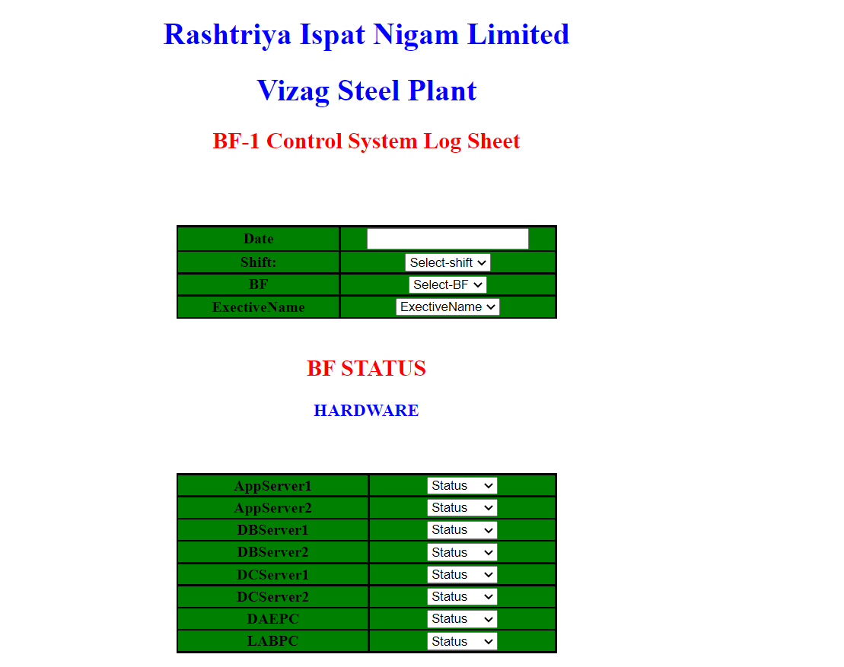
1.Introduction
The main purpose of doing this project is to update and store the data of the Blast Furnace in an website
So here Admin can able to “view the status” of the Blast furnace in the website and also the shift manager will able to “update the status” of the Blast furnace
Here we are given to design an full stack web site as per the requirement given by external guide

Slide 4
2. Objective
The main objective to do this project is to make the information of the blast furnace in an most better way of updating and seeing the status of the Blast furnace
The objective of this project is to develop the website using the latest technologies and to integrate it with back end server and make it as an full stack web application where we can have some funcanaties that provides the results

Slide 5
3. Technical Exposure Gained
HTML
CSS
BootStrap
Java Script
PHP
MySql

Slide 6
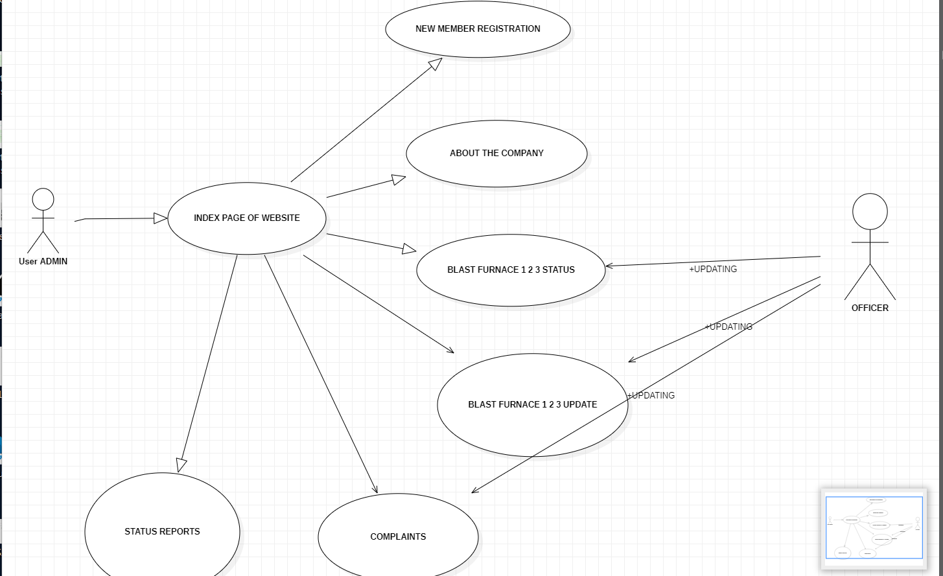
4. System Architecture

Slide 7
5. Implementation Details
1. User will login in index page
2. If the user is new he can register himself
3. After registering the user can also see the about page
4. After the user can go to main page and in that main page the user will find out all the options
5. And the user can logout to come to main page and the user is successfully logged out

Slide 8
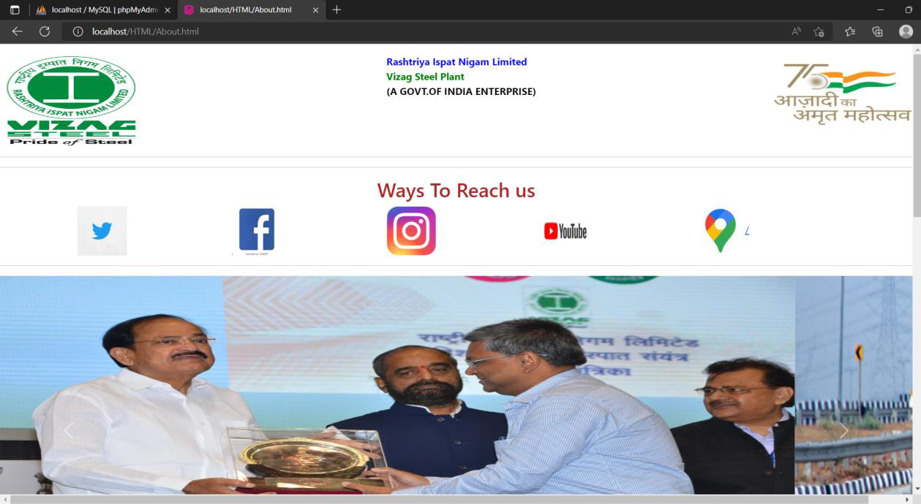
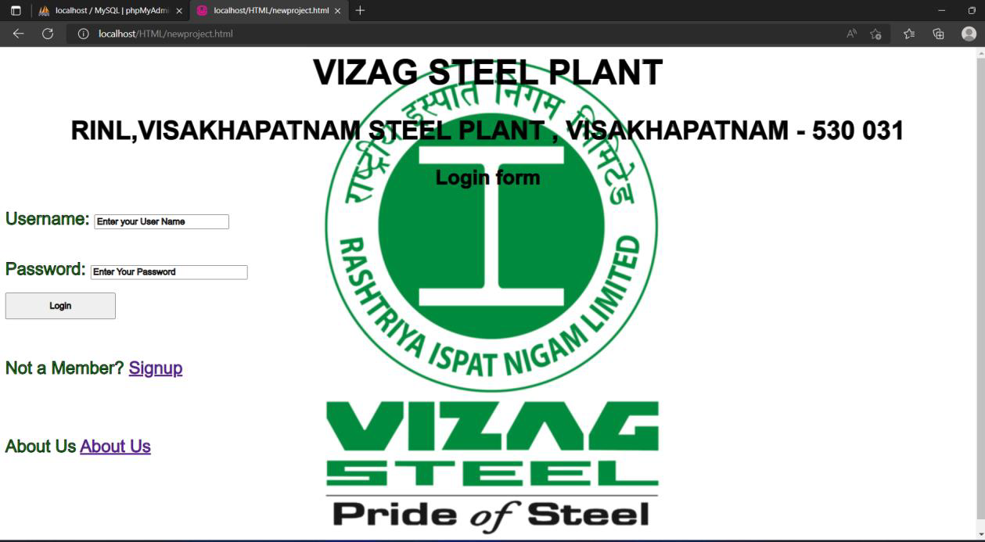
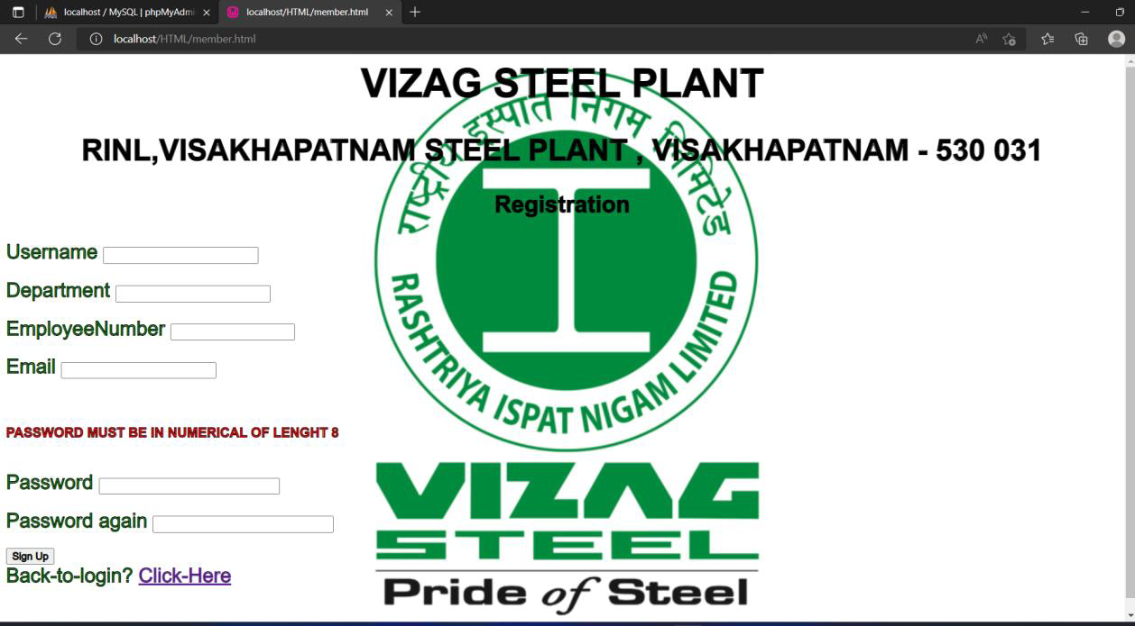
Continue…

Slide 9
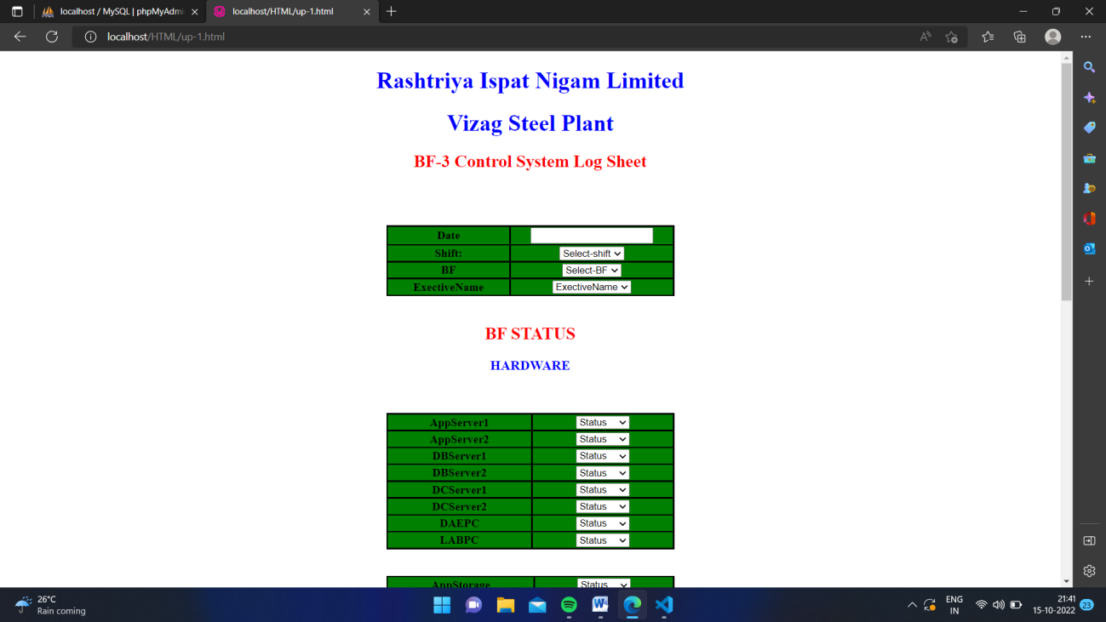
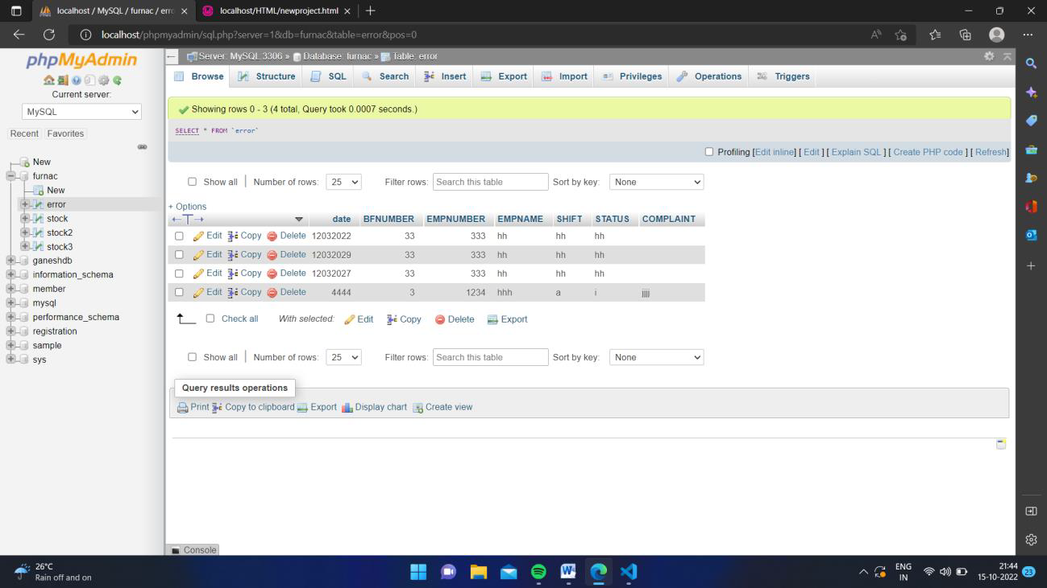
Continue…

Slide 10
6. Impacts of Internship
As per technical impact is that I have learned many new technologies which doing my internship and those are trending in the world right now and applied them on the real time application in steel plant which doing this internship I have learned the technologies like “Html, Css, Bootstrap, php and mysql” so while learning I have applied them on the real time problem and make sure that I have hands of experience of these technologies
Regarding other than technical thing the most impact thing is to work in a team and updating my progress to guide in regular intervals and clearing all the doubts regarding the project and coordinating the project with team members progress

Slide 11
7. Environment Learning
There are various streams to have internships in the IT background in the industry and there are many high level qualified guides in the industry to guide and we can have hands on sessions in the presence of the guide which will enhance the technical skills of the students
There is a lots of advance computers and the many things , to learn how the real time a project is deployed and how the databases working and we can also see how the guides maintain the computer programs

Slide 12
8. Conclusions and Future Directions
In conclusion I would say that this internship has been one the most remarkable experience I
have had so far. It helped reinforce my knowledge of responsibility, focus, drive and ambition.
We all know that practical experience is the best, and internships give students that hands-on
experience they need. I feel that quality internships are essential to develop key skills. Skills such
as multitasking, communicating, learning to deal with diversity, and dealing with deadlines are
different when you are working under someone. Internships are also a great way to network with
people in the industry

Slide 13
Continue..
I would say that this internship has primed me with the necessary exposure to the real world. This experience has only gotten me more excited to continue in this field for my career. Experience and coping with new systems is essential to any field of career.
In Future learning new skills and trying to apply as many internships of my liked domain and working under different pressure situations and handle them and trying to get an full time paid internship to words to domain which I am currently working on

Slide 14
Thank You

